Slide 1

Proposal for Building PwC BroadVision Capability
Ekow Nelson

Slide 2
Contents
Who are BroadVision?
Why BroadVision?
BroadVision Project Roles
BroadVision Education Curriculum
BroadVision Skills and Training Matrix
Skill Requirements
Training volumes forecast
Training Approach
The BroadVision Train The Trainer (TTT) Programme
Entry Criteria for TTT
PwC EMA BroadVision Training Timeline

Slide 3
Who are BroadVision?
Leading world-wide supplier of personalised e-business applications.
BroadVision applications enable companies and government entities to personalise communications, transactions, and services to match the needs of employees, partners, and customers-the extended enterprise.
Designed to support a range of touch points including Web TV, PDAs, WAP devices and integrates with existing systems including call centres, e-mail etc.
Highly rated E-business technology vendor: ranked Number 2 in Business Week Infotech 100 (November 1999) ahead of Microsoft, Compaq, Vodafone.
Customers include Citibank, Wal-mart, Boots, British Telecom, Vodafone, Toyota, Hewlett Packard, Sears, Sony, US Postal Services etc.
Established in 1993 with Market Capitalisation of US$12billion

Slide 4
Why BroadVision?
Established in Europe for 4 years with strong dedicated vertical sales force.
Forecast to win ~100 projects in EMEA over the next 12 months. PwC are in line to take a minimum of 20, possibly as many as 40.
Moving away from using Web design houses and small systems integration partners due to complexity and scale of current and future projects
Main European partner is SEMA, with 50 people trained. SEMA do not have strong consulting skills, and cannot help the customer with a commercial strategy. Also SEMA resell BV licences and cream off 30% !
Interested in PwC’s project management skills and large scale systems integration capability
We aim to become BroadVision's integrator of choice by becoming the first integrator certified to BroadVision's Platinum Standard within 6 months, and training 100-150 people over the next 12 months. (This figure will be carefully matched to Sales Forecasts)

Slide 5
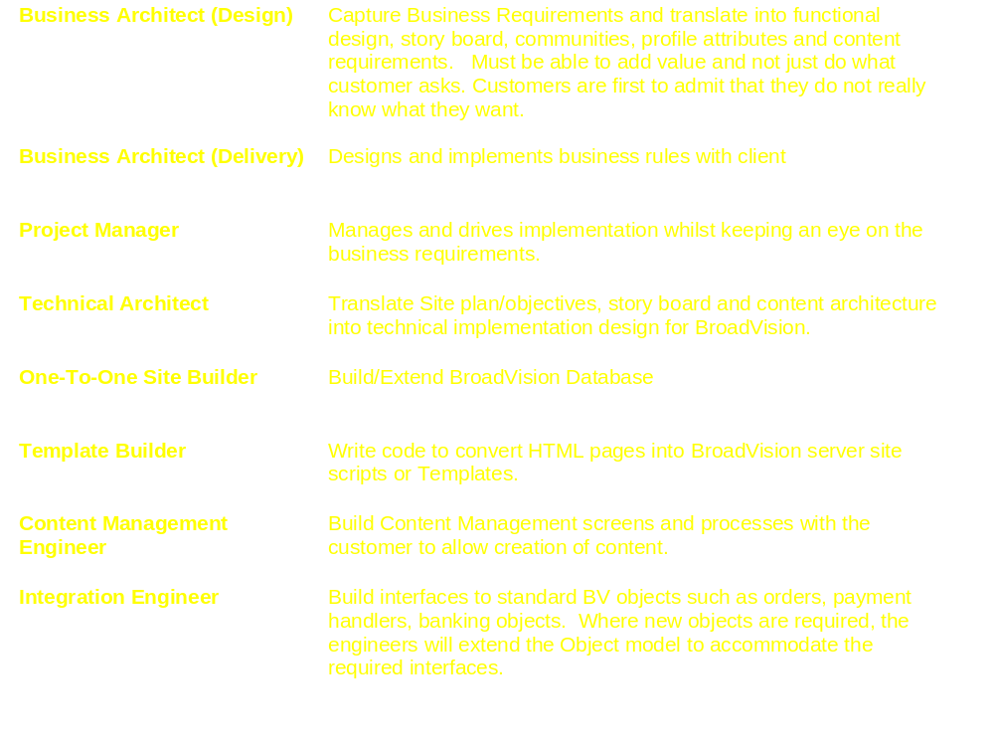
Key BroadVision Project Roles

Slide 6
Broadvision Curriculum
Business Manager’s Course
BMGR1
BMGR2
Appdev2 (Advanced Scripting)
AppDev1
(BV Scripting)
Appdev2 (BV Components)
Appdev2 (System Administration)
Recommend pre-requisite
Mandatory pre-requisite
Appdev2 (Performance & sizing)

Slide 7
BroadVision Curriculum
Business Manager 1
  Designed for those responsible for developing business requirements for a dynamic web site. It introduces students to the BroadVision system architecture with emphasis on BroadVision's business tools for managing a dynamic web site. It focuses on strategic planning, rather than specifics of how to use the tools.
Business Manager 2
  Designed for those responsible for creating and managing content and developing rule-based logic that will deliver this content dynamically to Web site visitors. Aims to equip students with the skills required to apply an organisation's business logic and personalization strategies using BroadVision.
Application Developer 1 (20-25 UK PwC consultants trained)
  Provides students with architectural overview and technology fundamentals. Includes information on how to build dynamic pages using BroadVision's 4.1 script and components architecture.
Advanced Scripting
  Designed to provide students with "Best Practices" for writing BroadVision JavaScript programs.
BV Components
  This course provides lectures on the "Best Practices" of writing BroadVision components and CORBA servers for One-To-One applications. Hands on exercises reinforce lecture topics. The participants will also learn to use Purify to assure memory efficiency in their C++ code.
Notes:
BM1 concentrates on strategic planning for dynamic web set
BM2 implement business rules in BV
Appdev1 - architecture overview and BV scripting

Slide 8
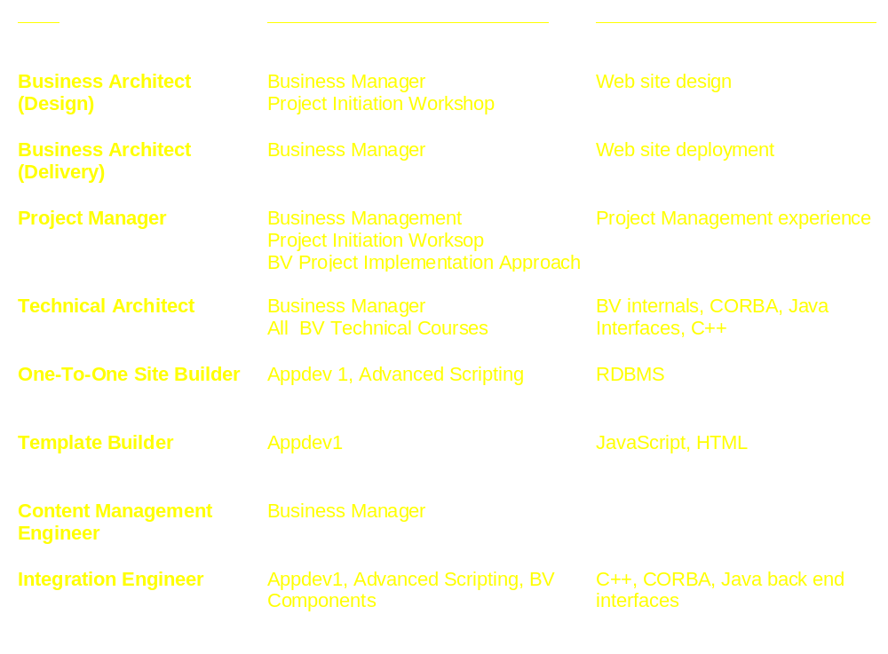
BroadVision Skills and Training Matrix

Slide 9
Skill Requirements
To deliver 20 BroadVision projects in EMEA we will require at least:
  20 BV Project Managers
  10 Technical Architects
  10 Business Design Architects
  20 Business (Delivery) Architects
  40 One-to-One Site Builders (2 for each project)
  40 Integration Engineers (2 for each project)
  20 Template Builders
  20 Content Managers

Slide 10
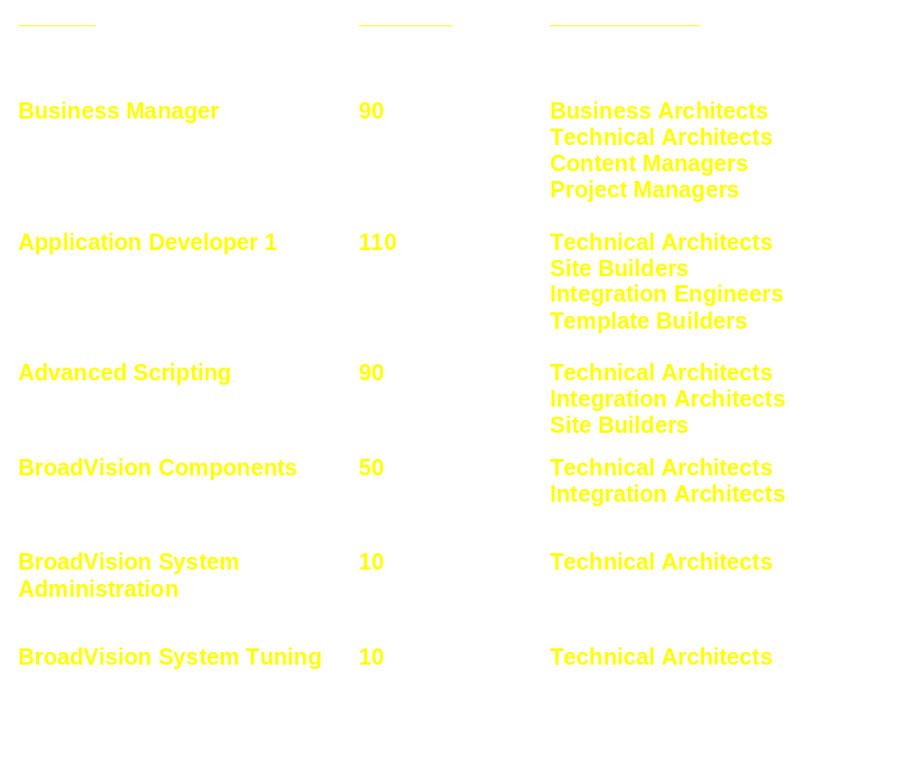
Training Volumes Required to support forecast
{
PwC will deliver these three internally!

Slide 11
Training Approach
We aim to deliver Business Manager, Application Developer and Advanced Scripting through Learning Point on a ‘by invitation only’ basis
Until PwC has qualified BroadVision trainers, the above will be arranged on an ‘as needed’ basis through BroadVision
Other technical courses will be provided by BroadVision and will be arranged either as special PwC classes or through the standard BV training catalogue

Slide 12



The BroadVision Train The Trainer Programme
Two Tracks:
  Technical Track (2 levels)
  Business Manager Track
Technical Track
Attend courses:
Appdev1
Advanced Scripting
System Administration
Certified to Teach Appdev1!
Write exam
Co-teach Appdev 1 with BroadVision instructors
Pass Mark 80%
Time scales:
Course attendance =8 days
Self study=14 days
Co-teach = 3 days
Certified to Teach Advanced Scripting!
Write exam

Slide 13
The BroadVision Train The Trainer Programme (2)
Business Track
Certified to Teach Business Manager Courses!
Attend courses:
Business Manager 1
Business Manager 2
Co-teach Business Manager 1 & 2 with BroadVision instructors
Write exam
Pass Mark 80%
Time scales:
Course attendance =3 days
Self study= 7 days
Co-teach = 3 days

Slide 14
Entry Criteria (Technical Track)
Technical:
  Experience with HTML
  Understand object oriented programming concepts
  Internet application development experience (minimum one year)
  Experience with scripting language
Teaching/presentation:
  Candidates must have teaching or related presentation experience.
  Candidates may be required to deliver a brief presentation to the TTT Program Manager to confirm this requirement.
Other:
  Candidates' resumes must be made available to the TTT Program Manager for review before acceptance.
  BroadVision reserves the right to refuse any suggested candidates who do not meet these requirements.

Slide 15
Entry Criteria (Business Track)
Teaching/presentation:
  Candidates must have teaching or related presentation experience.
  Candidates may be required to deliver a brief presentation to the TTT Program Manager to confirm this requirement.

Slide 16
Other
How many trainers do we need ?
  2-3 Technical Trainers
  1-2 Business Manager trainers
  … to cover all of EMEA
The Train The Trainer programmer will be funded by EMEA E-business Central
If you are interested or have a candidate to put forward please contact Ekow Nelson Tel: +44 (0) 171 212 2169
Upcoming Special BroadVision Classes
  Business Manager (mid-February TBC)
  Application Developer (7th February TBC)
  Advanced Scripting (mid-February TBC)

Slide 17



PwC EMEA BroadVision Training Timeline
Dec ‘99
Mar ‘00
Specially arranged BroadVision classes for projects (e.g. Lloyds TSB) and various business groups
Feb ‘00
Mar ‘00
Trainer the Trainer Programme
Apr ‘00
Jul ‘00
Internal BroadVision Training available through Learning Point

Slide 18
BroadVision Sites
In the meantime you may like to visit the following BroadVison sites:
www.vodafone.net (Vodafone Interactive)
www.boots.co.uk (Boots)
www.bt.com (British Telecom)
www.tdwaterhouse.co.uk (TD Waterhouse Brokerage)
www.lite.citifi.com (CitiBank)
www.airmiles.co.uk (Airmiles)
www.shockwave.com (Macromedia Shockwave Site)
www.aa.com (American Airlines)
www.shopping.hp.com (HP Shopping Village)

